Slide 1
Modeling March Madness with Python
Follow along at:
github.com/nicholas-vogt/modeling-march-madness
Notes:
Open these links for easy access during presentation:
http://www.sports-reference.com/cbb/boxscores/index.cgi?month=02&day=03&year=2017
Keep in mind:
Speak slowly and clearly.
Keep people involved.

Slide 2
Who am I? Nick Vogt
B.S. Economics & Computational Mathematics
Vice President, Co-Founder, MSU Data Science
Python Enthusiast
Sports Fanatic
Future Data Scientist at Ford

Slide 3
Part One of a Four Part Series!
Required Knowledge:
Beginner Knowledge of Python 3
A Healthy Interest in Statistics and Machine Learning
Web Scraping
Data Mining
Choosing a Model
Model Evaluation
I will share each presentation at facebook.com/MSUDataScience
Notes:
Today, we’ll only need to know about Python

Slide 4
Part 1 of 4: Web Scraping
Follow along with the web-scraping.ipynb notebook.

Slide 5
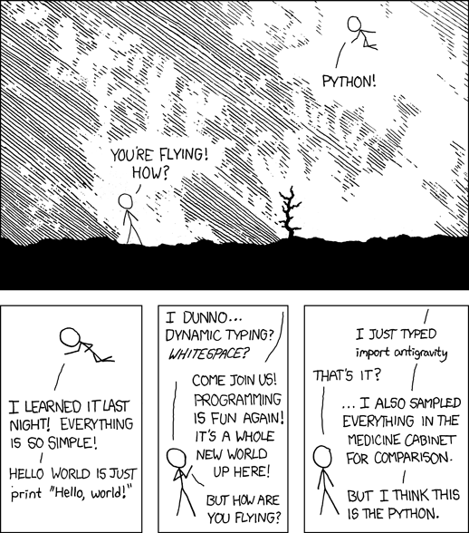
You only need Python 3.5+ to follow along!

Slide 6
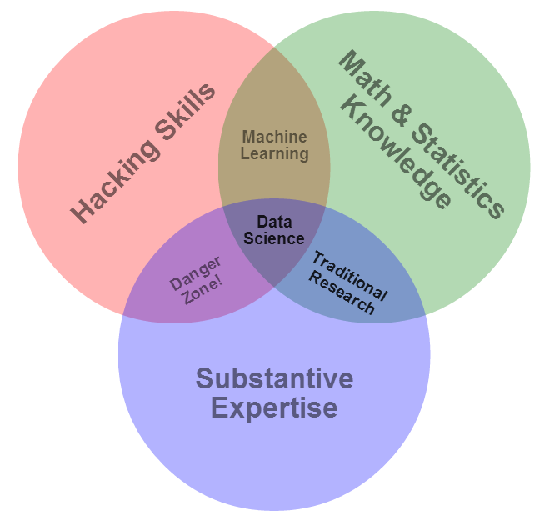
Why are we here?

Slide 7
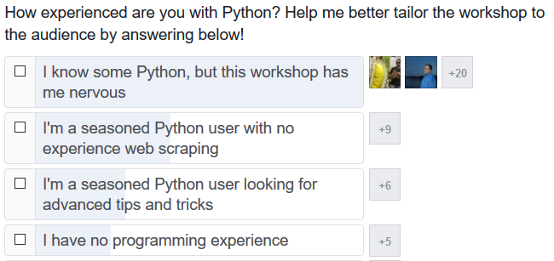
Why are we here?

Slide 8
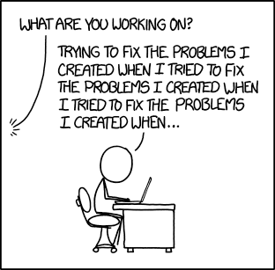
Why are we here?

Slide 9
What you can expect
How and why we need to scrape.
Avoid bans from sites you’re scraping.
Designated question slides after each section.
Bonus tips to point experienced Python users in the right direction.
What else do you hope to learn?

Slide 10

Presentation Format
State goals
Explain the how and why
Split b/t Powerpoint and Python
Bonus tips for experienced users
Pause for questions after each section
Focus on content rather than Python syntax

Slide 11
What’s Ahead
Why Do I Need to Scrape?
The requests Library
Navigating HTML
Crawling
Legal Stuff
Program Architecture

Slide 12
Why Do I Need Web Scraping?
Data Mining is Sexy
Web scraping is data mining’s less attractive, dumpy friend.
You have an interesting question, but no data. What do you do?
Create your own data
Large companies can do this. You cannot do this.
Use open data
/r/opendata, /r/datasets, various github repositories.
Steal Scrape the data
Your weapon of last resort.
Notes:
Farmer Analogy
If you have no food, you have some options:
Create your own data (start a garden)
Use Open Data (go to McDonald’s)
Scrape the data (go grocery shopping)

Slide 13
But Do I Need Web Scraping? (Nick’s Favorite Acronym)
emands
nline sources
etwork
ry something else
“That seems hard. Should I do it?”
D
O
N
T
Notes:
DEMANDS
Do your questions make sense?
Will your model answer the questions you’re asking?
What data do you need to do the analysis?
Make a list of variables; are they attainable?
ONLINE SOURCES
There are countless “opendata” databases available for free online.
Forums like Reddit and Quora are great for asking questions.
Python may have a module that retrieves the data you’re looking for.
Best case: someone already did the same project!
NETWORK
Talk to a professor about your project.
Search databases available only through MSU’s paid subscriptions.
TRY SOMETHING ELSE
The first solution is rarely the best solution.
Think about the problem for 5 minutes, then continue.
Is it even worth your time?
Web scraping programs can be time-consuming to create.
Many online sources are structured in simple HTML
But many more are generated with jquery
Difficult to maintain.
Many websites frequently change their layouts.

Slide 14
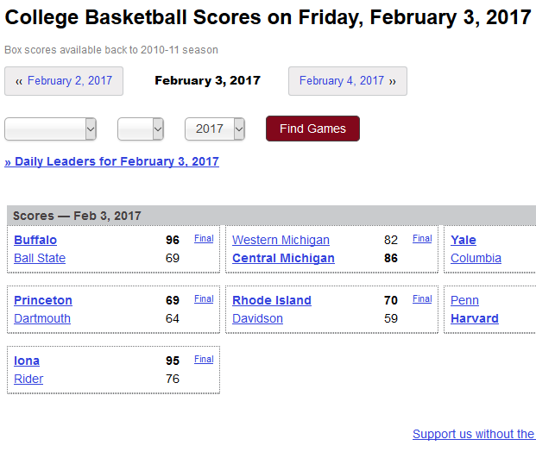
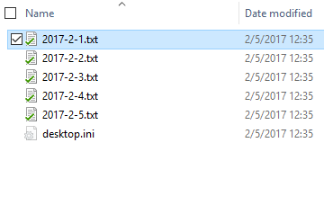
What’s the Goal?
Go from here…
To here

Slide 15
Two Ways to Participate
github.com/nicholas-vogt/modeling-march-madness
Follow along with the github repo.
Clone the repo and make notes as we go.

Slide 16
The requests Library
Ask nicely and you get a webpage.

Slide 17
Why scrape the whole page?
Avoid extra calls to the server when debugging mining script.
Protect formatting in case of future changes to webpage.

Slide 18
Write raw html
If you're writing and debugging code, store the data locally. There are two good reasons:
Sending the same request to a server dozens or possibly hundreds of times puts unnecessary burden on their systems.
It's faster to pull data from a local file.
Always write encoded bytes.
If you don't yet know why, check out Ned Batchelder's PyCon talk. Watch every second of it.
Add an ID number to each html file.
Hexadecimal is easily recognizable as an ID in your dataset.
Notes:
Store data locally
Always write encoded bytes
It’s a headache you don’t want.
ID your html files.
I had a case where there were two football players with the same name. It’s bullshit, but it can happen.
Why hexadecimal? A column of numbers or illegible strings aren’t obviously ID numbers. Hexadecimal is easy to see and recognize as an ID number.

Slide 19
Bonus Tips
The requests library has two ways to view html
requests.content returns a Unicode encoded byte string
Print and notice the "b" before "<!doctype html>”
requests.text returns decoded utf-8
Circumvent smarter web design (but be careful)
Create a Session object (requests.Session)
Activate your favorite VPN
Copy the headers used by your VPN (HTTP Headers is a good chrome extension)
Update Session.headers attribute to the headers used by your VPN.
Notes:
Return encoded bytes or text depending on your needs
Outsmart the webdev

Slide 20
Questions?

Slide 21
Navigating HTML
Everything is a tree

Slide 22
<h1>Review of HTML</h1>
Hyper-Text Markup Language
Structured Data
How the internet talks
You don’t need to be a web dev to scrape effectively!
If you get confused along the way, I encourage you to take Codecademy's HTML Basics course. It's short and explains things better than I can in this workshop.
Notes:
Hypertext: Think “hyperlink.” Hypertext facilitates linking topics within text.
HTML is structured data

Slide 23
Let’s Talk about Trees
Nick’s Workshops 2017
/data
cbb-scores-2016-2017.csv
/src
Scraper.py
web-scraping-with-beautiful-soup.ipynb
1 Web Scraping with BeautifulSoup.pptx
2 Mining and Feature Engineering.pptx
3 Choosing a Model.pptx
4 Model Evaluation.pptx

Slide 24
Let’s Talk about Trees
Nick’s Workshops
/data
1 Web Scraping with BeautifulSoup.pptx
cbb-scores…
/src
Scraper.py
web-scraping…
2 Mining and Feature Engineering.pptx
3 Choosing a Model.pptx
4 Model Evaluation.pptx

Slide 25
HTML stores information as a tree
HTML
head
h1
Nick’s Workshop
body
title
Nick’s Workshop
h3
Welcome!

Slide 26
HTML stores information as a tree
HTML
head
title “Nick’s Workshop”
body
h1: “Nick’s Workshop”
h3: “Welcome!”
<html>
<head>
<title>Nick’s Workshop</title>
</head>
<body>
<h1>Nick’s Workshop</h1>
<h3>Welcome!</h3>
</body>
</html>

Slide 27
Questions?

Slide 28
Make the crawler crawl
Like learning to walk, only with code.

Slide 29
Make the crawler crawl
We often want to follow internal links on webpages to get to more interesting data.
BeautifulSoup will help us navigate HTML documents.
We’ll cover this library in more depth in the data mining workshop. It’ll be more important there.
Here's the plan of attack:
Identify links in a webpage.
Follow those links.

Slide 30
Quick intro to BeautifulSoup
We can navigate the tree using html tags in one of two ways:
BeautifulSoup attributes
BeautifulSoup find and find_all methods
Attributes and the find method will always find the first instance which matches the specifications.
Use find_all to find all matches.
Link attributes look like this:
<a href=“http://google.com”>Google</a>
We can extract information about the attribute using the get() method.

Slide 31
Bonus Tips
Be careful of what objects are being returned.
The find method returns a Tag object.
The find_all method returns a ResultSet object.
You can’t chain ResultSet objects together like you can with Tag attributes and methods.
In practice, we need more information to find the proper links.
Chrome has a SelectorGadget add-on which makes finding the proper html tags much easier.
We’ll cover this in more depth during the data mining workshop. It has deeper applications there.
Notes:
Be careful of what objects are being returned.
The find method returns a Tag object.
The find_all method returns a ResultSet object.
You can’t chain ResultSet objects together like you can with Tag attributes and methods.
In practice, we need more information to find the proper links.
Chrome has a SelectorGadget add-on which makes finding the proper html tags much easier.
We’ll cover this in more depth during the data mining workshop. It has deeper applications there.

Slide 32
Following internal links
We now know how to find internal links on a page. There are two things we want to do next:
Scrape the box scores for more game data;
Find scores from different dates.
We'll switch gears now to scraping NCAA basketball box scores on sports-reference to demonstrate.
Notes:
We now know how to find internal links on a page. There are two things we want to do next:
Scrape the box scores for more game data;
Find scores from different dates.
We'll switch gears now to scraping NCAA basketball box scores on sports-reference to demonstrate.

Slide 33
Absolute and relative paths
Web pages contain absolute paths and relative paths.
An absolute path contains the entire address to a link.
A relative path contains the address relative to another base address.
Internal links almost always contain relative paths.
For example, the link to college basketball stats on sports-reference is "/cbb".
The web pages knows this is an internal link and will send the user to http://sports-reference.com/cbb.
To get the box score data, we must make a similar correction.
Notes:
Web pages contain absolute paths and relative paths.
An absolute path contains the entire address to a link.
A relative path contains the address relative to another base address.
Internal links almost always contain relative paths.
For example, the link to college basketball stats on sports-reference(http://sports-reference.com) is "/cbb". The web pages knows this is an internal link and will send the user to http://sports-reference.com/cbb.

Slide 34
Absolute and relative paths
Web pages contain absolute paths and relative paths.
An absolute path contains the entire address to a link.
A relative path contains the address relative to another base address.
Internal links almost always contain relative paths.
For example, the link to college basketball stats on sports-reference is "/cbb".
The web pages knows this is an internal link and will send the user to http://sports-reference.com/cbb.
To get the box score data, we must make a similar correction.
Notes:
Web pages contain absolute paths and relative paths.
An absolute path contains the entire address to a link.
A relative path contains the address relative to another base address.
Internal links almost always contain relative paths.
For example, the link to college basketball stats on sports-reference(http://sports-reference.com) is "/cbb". The web pages knows this is an internal link and will send the user to http://sports-reference.com/cbb.

Slide 35
Bonus Tips
We may be tempted to navigate to other gamesheets the same way, but there’s a better way:
Notice the URL takes date parameters.
?month=01&day=22&year=2017
We can scrape the scores for a given date and use the date we specified.
This solves the additional problem of navigating to other dates. It will also makes the code much easier to read and debug later on.
URL parameters rarely require a specific order.
? year=2017&month=01&day=22
Notes:
We may be tempted to navigate to other gamesheets the same way, but there’s a better way:
Notice the URL takes date parameters.
?month=01&day=22&year=2017
We can scrape the scores for a given date and use the date we specified.
This solves the additional problem of navigating to other dates. It will also makes the code much easier to read and debug later on.
URL parameters rarely require a specific order.
? year=2017&month=01&day=22
To make it more legible, we can flip the order of month, day, year to a less ambiguous format.

Slide 36
Questions?

Slide 37
Legal Stuff
Check yourself before you wreck yourself.

Slide 38
Scraping Politely (not illegally)
Spiders, crawlers, scrapers, etc. are known as robots online.
Most sites have a robots.txt page which tells robots what they “can and cannot” scrape.
Many websites track IPs and other information to identify robots.
In my experience, these tracking services are either really bad or poorly maintained.
Websites pay money for their servers.
Your scraper uses server time that could instead go to real users.
Websites may ban your IP if they suspect your using a robot.
If you break the servers, you can be held liable for damages.

Slide 39
So what do you do?
Assign a 5 or 10 second crawl-delay to your scraper.
Left unchecked, your scraper may ping (i.e. contact) the server several times per second.
Most large websites (e.g. ESPN) can handle that kind of traffic.
Smaller sites cannot.
Don’t scrape if you can help it.

Slide 40
Program Architecture
Structure your program to make debugging and updating easier.

Slide 41
Program Architecture
Python is an object-oriented language.
Object-oriented code is the norm in industry (for better or worse).
Write object-oriented code.
Let’s walk through the Scraper class in the Scraper.py file.

Slide 42
Program Architecture
Simplify procedural code.
Document everything. You will forget it later.
Python 3.6 has type hints. Use them.

